Slide 1
GROUP NUMBER 09

Slide 2
PARTICIPANTS
NAMES | REGISTRATION NUMBERS
NOEL JACKSON HAMIS | NIT/BIT/2024/2449
ASANTE RABAN ABEL | NIT/BIT/2024/2559
ELIBARICK L. DAUD | NIT/BIT/2024/2589
ALLY M BENJAMIN | NIT/BIT/2024/2519
SADATI H KOLILOKO | NIT/BIT/2024/2459
JANETH H MPATILLAH | NIT/BIT/2024/2399
DENIS MWIRABI NUNGU | NIT/BIT/2024/2599
SHABAN R KITABU | NIT/BIT/2024/2479
SABRA H KIRONDA | NIT/BIT/2024/2539
YOHANA C RICHARD | NIT/BIT/2024/2609

Slide 3
PARTICIPANTS
NAMES | REGISTRATION NUMBER
JONATHAN S TAWELI | NIT/BIT/2024/2579
FELISTER M MUSSA | NIT/BIT/2024/2439
HELEN J JOHN | NIT/BIT/2024/2499
MUSA Y MNENWA | NIT/BIT/2024/2469
NEEMA LINUS MALYA | NIT/BIT/2024/2659
ANETI T WILIMOTI | NIT/BIT/2024/2389
VICENT I BALITAZALI | NIT/BIT/2024/2509
EDSON ROBERT | NIT/BIT/2024/2639
ZENGO J JINEGO | NIT/BIT/2024/2649
HAPPINESS V NJAU | NIT/BIT/2024/2629

Slide 4
PARTICIPANTS
NAMES | REGISTRATION NUMBERS
ROBERT D ROBERTY | NIT/BIT/2024/2079
NOVATUSI S AUGUSTINO | NIT/BIT/2024/2619
HAWA S AHMADI | NIT/BIT/2024/2419
KALEBO G MBEYANJE | NIT/BIT/2024/2569
SIKUDHANI I MNDOLWA | NIT/BIT/2024/2549
JAPHET J SENGATI | NIT/BIT/2024/2529
ABDUL F ABDALLAH | NIT/BIT/2024/2699
VICENT P JOSHUA | NIT/BIT/2024/2489
YUSUPH S SANGA | NIT/BIT/2024/2409
JOSHUA A. AKYOO | NIT/BIT/2024/2429

Slide 5
Void and pointer

Slide 6
C POINTERS
A pointer is a variable that stores the memory address of another variable as its value.
A pointer variable points to a data type (like int) of the same type, and is created with the * operator.

Slide 7
The memory address is the location of where the variable is stored on the computer.
When we assign a value to the variable, it is stored in the memory address.
To access it, we use the reference operator (&), and the result represents where the variable is stored:

Slide 8
EXAMPLE 1…
#include <stdio.h>
int main() {
int Age = 20;
int* p = &Age;
printf("%d\n", Age);
printf("%p\n", &Age);
printf("%p\n", p);
return 0;
}

Slide 9
Example 1 explained
#include <stdio.h>
is a preprocessor directive in C.
#include tells the C preprocessor to include the contents of another file before compilation.
<stdio.h> is a standard header file that stands for Standard Input/Output.
It declares functions and definitions used for input and output operations, such as:
printf() – output to the screen
scanf() – input from the keyboard
putchar(), getchar()
FILE type for file handling

Slide 10
CONT…
int main() {
Program execution starts from the main() function.
int Age = 20;
Declares an integer variable named Age and initialize variable Age value equal to 20
int* p = &Age;
Declares a pointer variable p that can store the address of an integer.
&Age gets the memory address of the variable Age.
That address is stored in p.
Now, p points to Age.

Slide 11
CONT…
printf("%d\n", Age);
Prints the value of Age.
Output: 20
printf("%p\n", &Age);
Prints the memory address of the variable Age.
%p is the format specifier used to print addresses.
Output: a hexadecimal address (e.g., 0x7ffeabc1234).

Slide 12
CONT…
printf("%p\n", p);
Prints the value stored in p.
Since p holds the address of Age, the output will be a hexadecimal address (e.g., 0x7ffeabc1234).
return 0;
}
Ends the execution of the main() function.
Sends the value 0 back to the operating system.
By convention, 0 means the program executed successfully without errors.

Slide 13
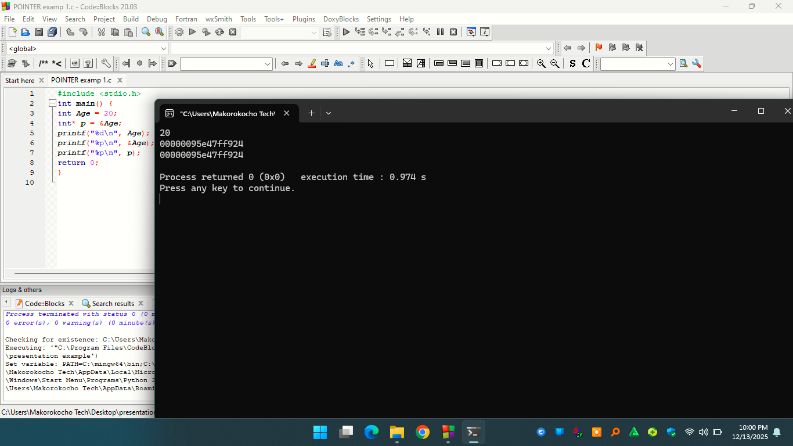
Output of example 1

Slide 14
Example 2
#include <stdio.h>
int main() {
int Age = 18;
int* p = &Age;
printf("%d\n", *p);
printf("%p\n", p);
return 0;
}

Slide 15
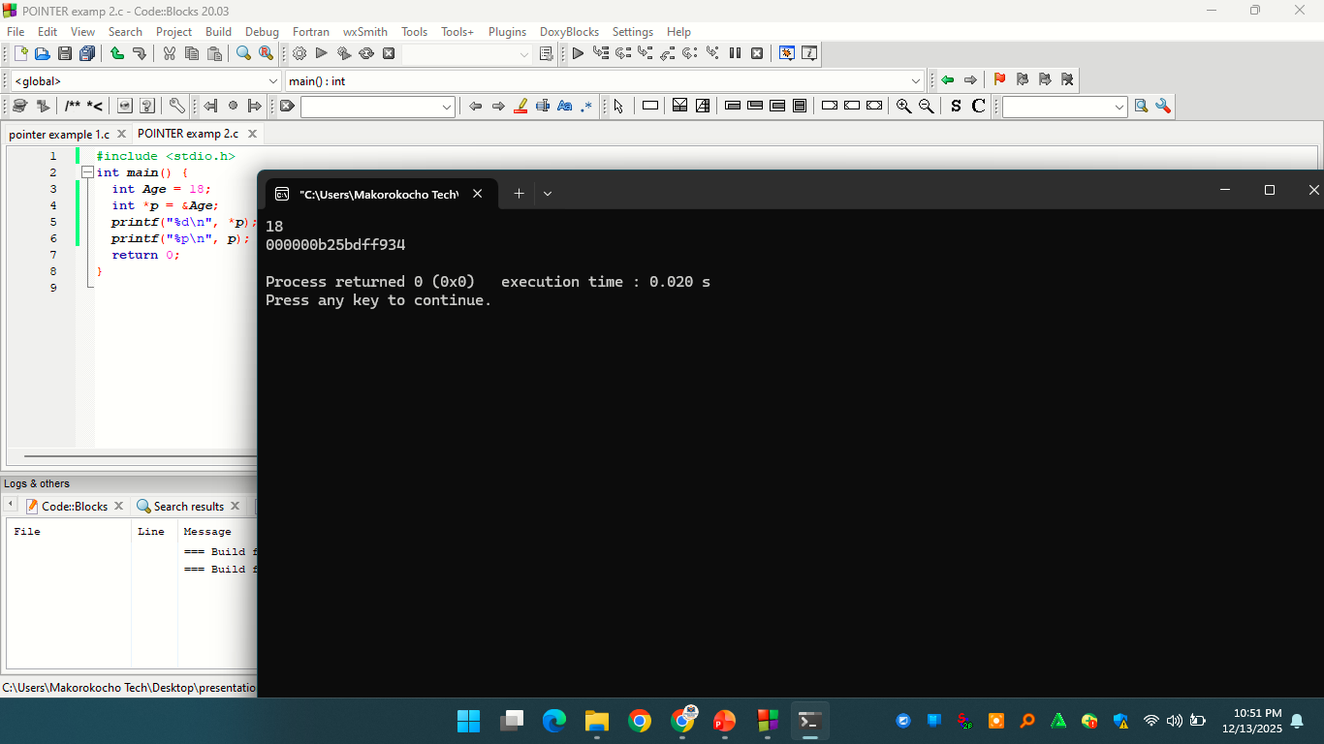
Output of Example 2

Slide 16
Note that the * sign can be confusing here, as it does two different things in our code:
When used in declaration (int* p), it creates a pointer variable.
When not used in declaration, it act as a dereference operator.
Good To Know: There are two ways to declare pointer variables in C:
int* p;
int *p;

Slide 17
Notes on Pointers
Pointers are important in C, because they allow us to manipulate the data in the computer's memory - this can reduce the code and improve the performance.
Pointers are one of the things that make C stand out from other programming languages, like Python and Java.
If you are familiar with data structures like lists, trees and graphs, you should know that pointers are especially useful for implementing those. And sometimes you even have to use pointers, for example when working with files and memory management.
But be careful; pointers must be handled with care, since it is possible to damage data stored in other memory addresses.

Slide 18
C Pointers and Arrays
We can also use pointers to access arrays.
Example of simple array
#include <stdio.h>
int main() {
int myNumbers[4] = {25, 50, 75, 100};
int i;
for (i = 0; i < 4; i++) {
printf("%d\n", myNumbers[i]);
}
return 0;
}

Slide 19
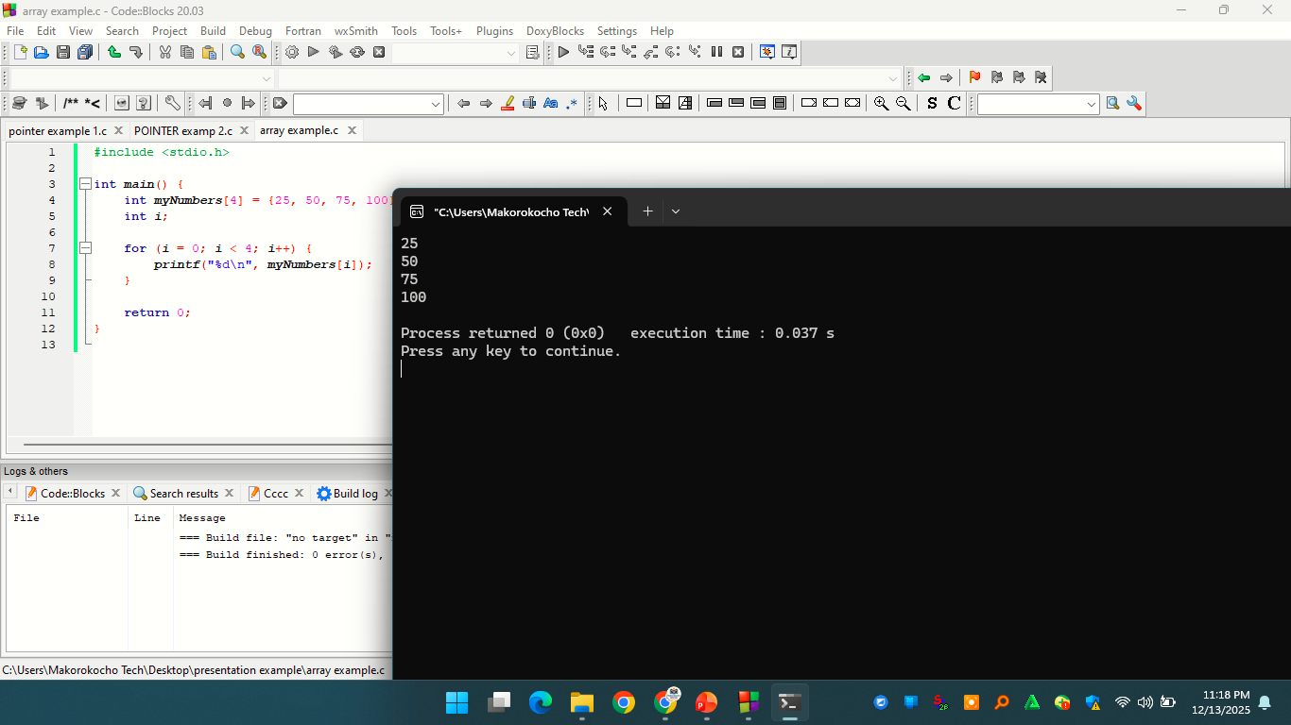
Example of simple array Output

Slide 20
C Pointers and Arrays
How pointer access arrays example 1
#include <stdio.h>
int main() {
int myNumbers[4] = {25, 50, 75, 100};
int i;
for (i = 0; i < 4; i++) {
printf("%p\n", &myNumbers[i]);
}
return 0;
}

Slide 21
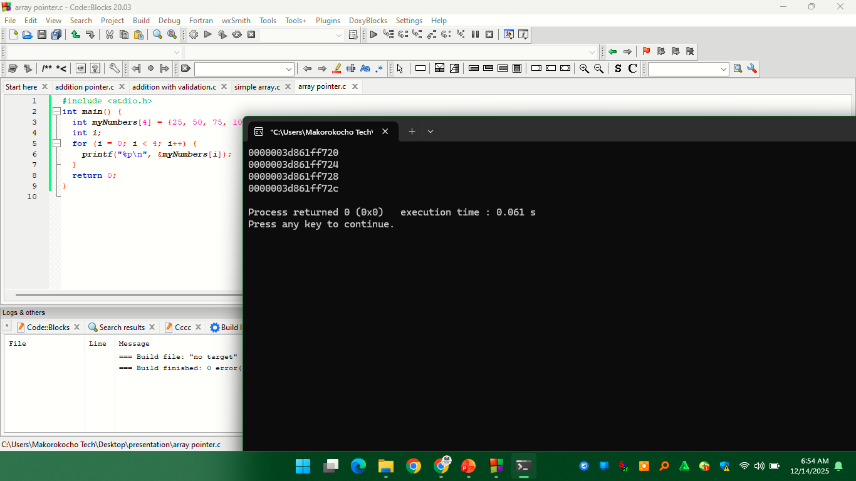
How pointer access arrays example 1 Output

Slide 22
How pointer access arrays example 1 Output Explained
myNumbers[0] → 0000003d861ff720
myNumbers[1] → 0000003d861ff724
myNumbers[2] → 0000003d861ff728
myNumbers[3] → 0000003d861ff72c
The output above shows the memory addresses where each element of the integer array is stored.
In C, array elements are stored in contiguous memory locations. Since the data type used is int, and an int typically occupies 4 bytes, each successive element in the array is placed 4 bytes after the previous one in memory.
As a result, the memory addresses increase by 4 each time, which means that the entire array takes up 16 bytes (4 * 4) of memory storage

Slide 23
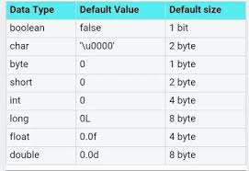
Size of (data_type)

Slide 24
How pointer access arrays Example 2
#include <stdio.h>
int main() {
int myNumbers[4] = {25, 50, 75, 100};
// Get the memory address of the myNumbers array
printf("%p\n", myNumbers);
// Get the value of the first element in myNumbers
printf("%d\n", *myNumbers);
// Get the value of the second element in myNumbers
printf("%d\n", *(myNumbers + 1));
// Get the value of the third element in myNumbers
printf("%d\n", *(myNumbers + 2));
// Get the value of the fouth element in myNumbers
printf("%d\n", *(myNumbers + 3));
return 0;
}

Slide 25
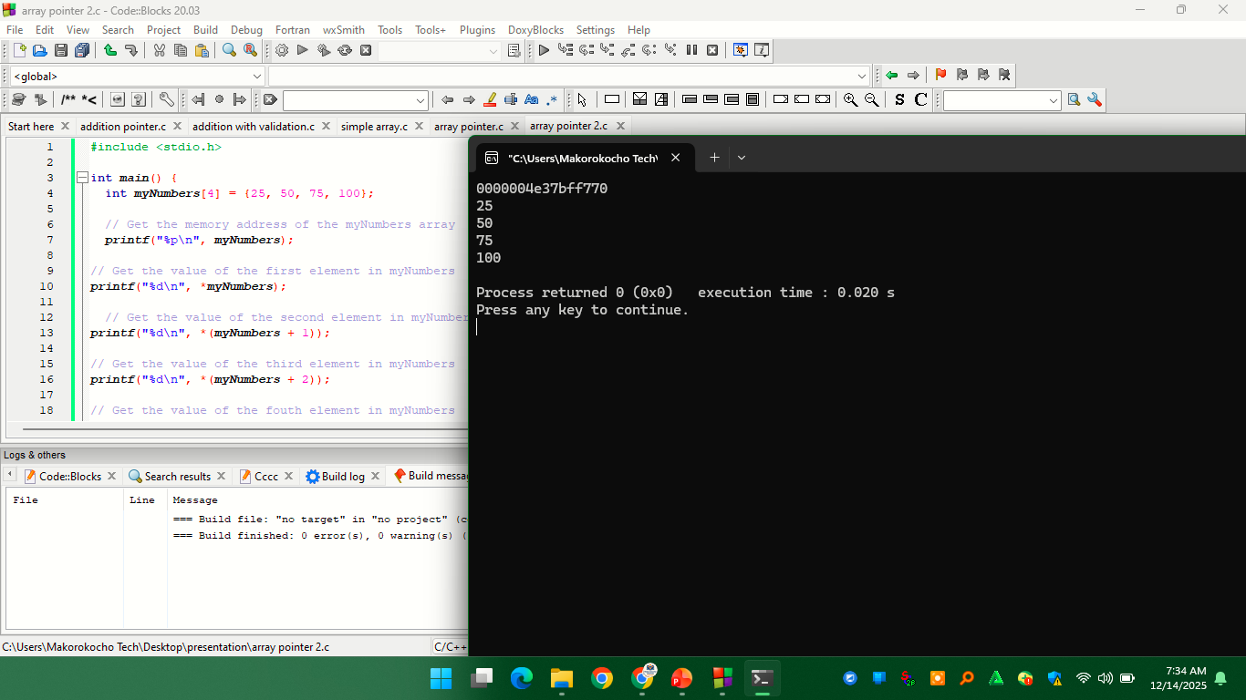
How pointer access arrays Example 2 Output

Slide 26
C Pointer Arithmetic
Pointer arithmetic means changing the value of a pointer to make it point to a different element in memory.
Increment and Decrement
We can move a pointer with ++ and -- (and with += / -=):

Slide 27
C Pointer Arithmetic example
#include <stdio.h>
int main() {
int myNumbers[3] = {10, 20, 30};
int *p = myNumbers; // myNumbers[0]
printf("%d\n", *p); // 10
p++; // move to myNumbers[1]
printf("%d\n", *p); // 20
p--; // back to myNumbers[0]
printf("%d\n", *p); // 10
p += 2; // jump to myNumbers[2]
printf("%d\n", *p); // 30
return 0;
}

Slide 28
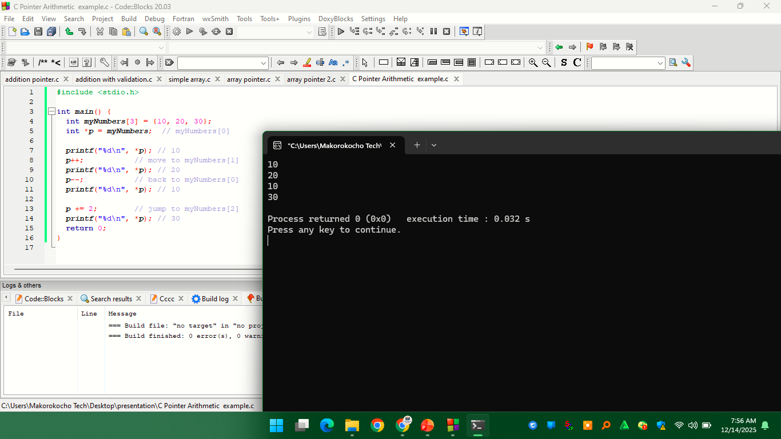
C Pointer Arithmetic example output

Slide 29
C Pointer Arithmetic
Pointer Subtraction (Distance)
we can subtract two pointers that point to elements in the same array to find out how many elements are between them. Example
#include <stdio.h>
int main() {
int myNumbers[5] = {10, 20, 30, 40, 50};
int *start = &myNumbers[1]; // points to 20
int *end = &myNumbers[4]; // points to 50
printf("%ld\n", end - start); // 3 elements apart
return 0;
}

Slide 30
Pointer Subtraction (Distance)
Here:
start points to the second element (20).
end points to the fifth element (50).
end - start gives the number of elements between them: 3.
Pointer subtraction only works when both pointers point into the same array. The result is measured in elements, not bytes.

Slide 31
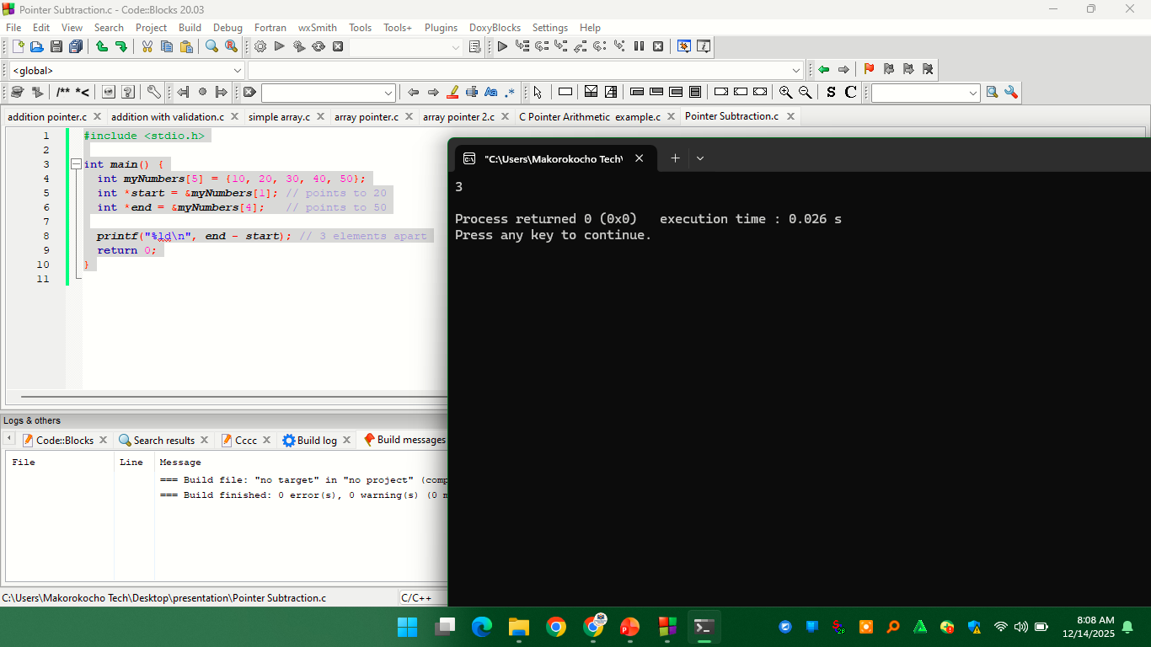
Pointer Subtraction (Distance) example output

Slide 32
Pointer Arithmetic Depends on Type
Not all pointers move the same way.
When you add 1 to a pointer, it moves forward by the size of the thing it points to - not just by 1 byte.
For example:
An int* pointer moves by the size of an integer (usually 4 bytes).
A char* pointer moves by the size of a character (1 byte).
So if both pointers start at memory address 1000:
int* → p + 1 would move to address 1004
char* → p + 1 would move to address 1001

Slide 33
Pointer Arithmetic Depends on Type example
#include <stdio.h>
int main() {
int myNumbers[2] = {1, 2};
char letters[] = "Hi"; // 'H', 'i', '\0'
int *pi = myNumbers; // int pointer
char *pc = letters; // char pointer
printf("%p\n", (void*)pi);
printf("%p\n", (void*)(pi + 1)); // moves by sizeof(int)
printf("%p\n", (void*)(pi + 2)); // moves by sizeof(int)
printf("%p\n", (void*)pc);
printf("%p\n", (void*)(pc + 1)); // moves by 1 byte
return 0;
}

Slide 34
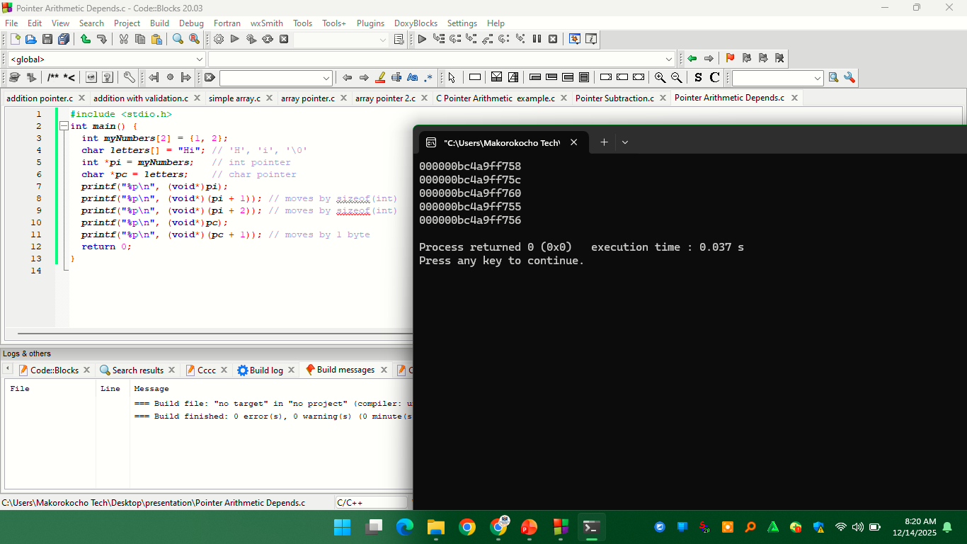
Pointer Arithmetic Depends on Type example output

Slide 35
Pointer Arithmetic
Looping with Pointers
moving the pointer itself inside the loop. Each time the pointer is increased (p++), it moves to the next element in memory. Example
#include <stdio.h>
int main() {
int myNumbers[4] = {25, 50, 75, 100};
int *p = myNumbers; // start of array
for (int i = 0; i < 4; i++) {
printf("%d\n", *p);
p++; // move to next element
}
return 0;
}

Slide 36
Looping with Pointers
Here's what happens in each loop:
*p gives the current element value.
p++ moves the pointer to the next element in the array.
No array index (i) is needed - the pointer keeps track of the position.

Slide 37
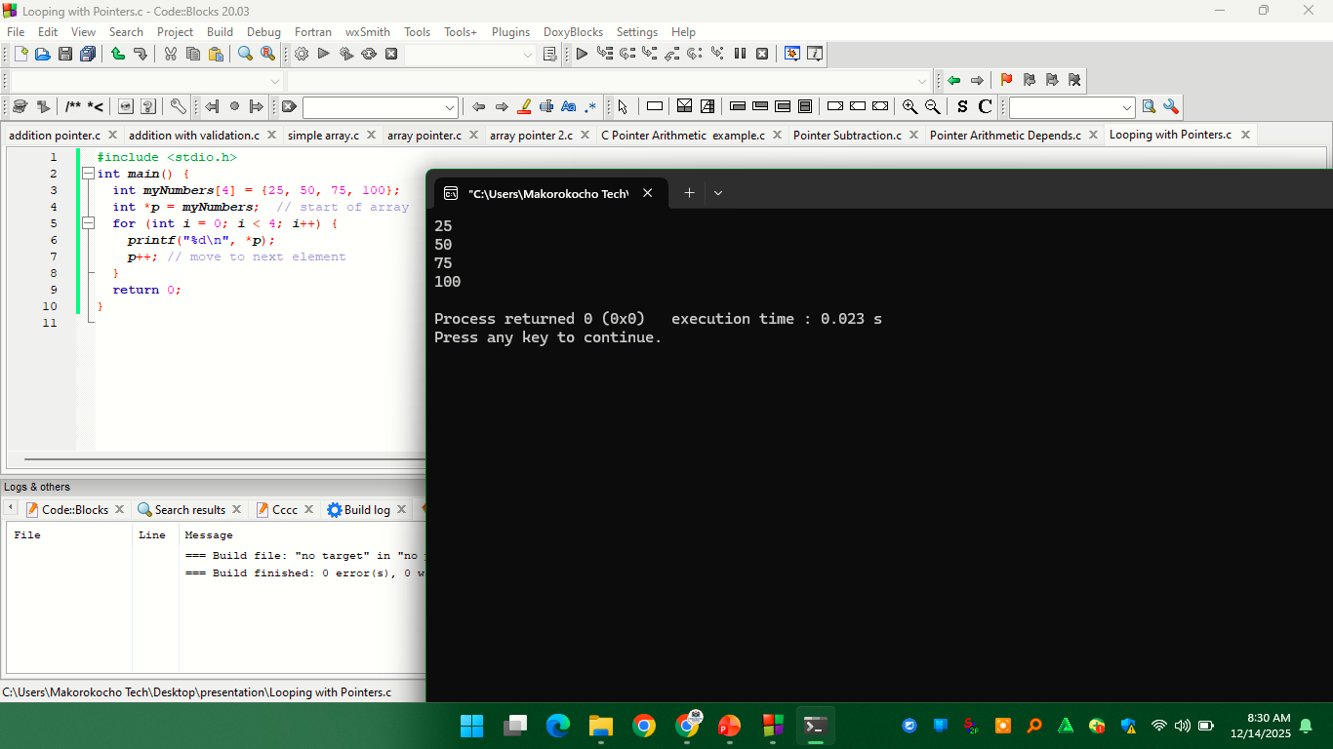
Looping with Pointers example output

Slide 38
Common Mistakes to Avoid
Using the wrong type: Remember that pointer movement depends on its type. An int* moves in 4-byte steps, but a char* moves 1 byte at a time. Mixing them up will point to the wrong memory locations.
Uninitialized pointers: Always make sure a pointer is pointing to something real before you use it. Using a pointer that doesn't point anywhere can crash our program.
Going out of bounds: Never move a pointer past the end of an array or before it starts. The only safe "outside" position is one step past the end, and that's only for comparing pointers - not for accessing values.
And be careful; pointers must be handled with care, since it is possible to damage data stored in other memory addresses.

Slide 39
C Pointer to Pointer
pointer that points to another pointer. This is called a pointer to pointer (or "double pointer") . example
#include <stdio.h>
int main() {
int myNum = 10; // normal variable
int *ptr = &myNum; // pointer to int
int **pptr = &ptr; // pointer to pointer
printf("myNum = %d\n", myNum);
printf("*ptr = %d\n", *ptr);
printf("**pptr = %d\n", **pptr);
return 0;
}

Slide 40
C Pointer to Pointer
Here's what happens step by step:
myNum holds the value 10.
ptr holds the address of myNum.
pptr holds the address of ptr.
*ptr gives the value of myNum.
**pptr also gives the value of myNum, by going through both pointers.
So:
*ptr = value of myNum
**pptr = value of myNum through both levels

Slide 41

C Pointer to Pointer example output

Slide 42
Changing Values Through a Pointer to Pointer
Since **pptr accesses the original variable, you can use it to change the value of the variable too .Example
#include <stdio.h>
int main() {
int myNum = 5;
int *ptr = &myNum;
int **pptr = &ptr;
**pptr = 20; // changes myNum
printf("myNum = %d\n", myNum);
return 0;
}

Slide 43
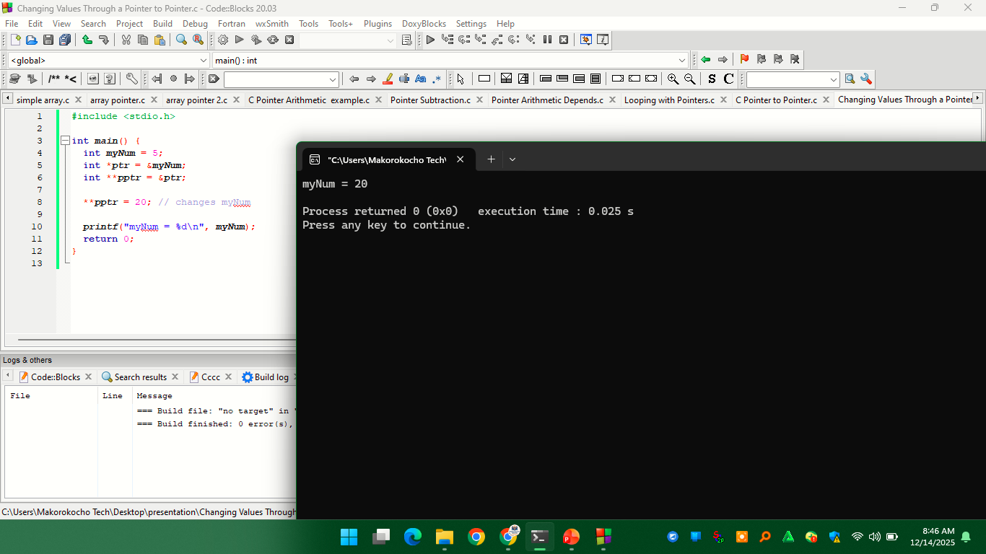
Changing Values Through a Pointer-to-Pointer output

Slide 44
ALOGARITHMS AND C CODE FOR DEMOSTRATE POINTERS
Algorithm: Addition of Two Numbers Using Pointers
Step 1: Start
Step 2: Declare variables
Declare two integer variables to store the numbers and one variable to store the sum.
Declare two integer pointer variables.
Step 3: Input values
Ask the user to enter two numbers and store them in the variables.
Step 4: Assign addresses to pointers
Assign the addresses of the two input variables to the pointer variables.
Step 5: Perform addition using pointers
Dereference the pointers to access the values and add them.
Step 6: Display the result
Output the sum of the two numbers.
Step 7: Stop
End the program.

Slide 45
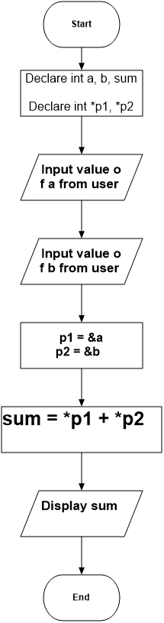
FLOWCHART

Slide 46
C PROGRAM
#include <stdio.h>
int main() {
int a, b, sum;
int *p1, *p2;
printf("Enter first number: ");
scanf("%d", &a);
printf("Enter second number: ");
scanf("%d", &b);
p1 = &a;
p2 = &b;
sum = *p1 + *p2;
printf("Sum = %d\n", sum);
return 0;
}

Slide 47
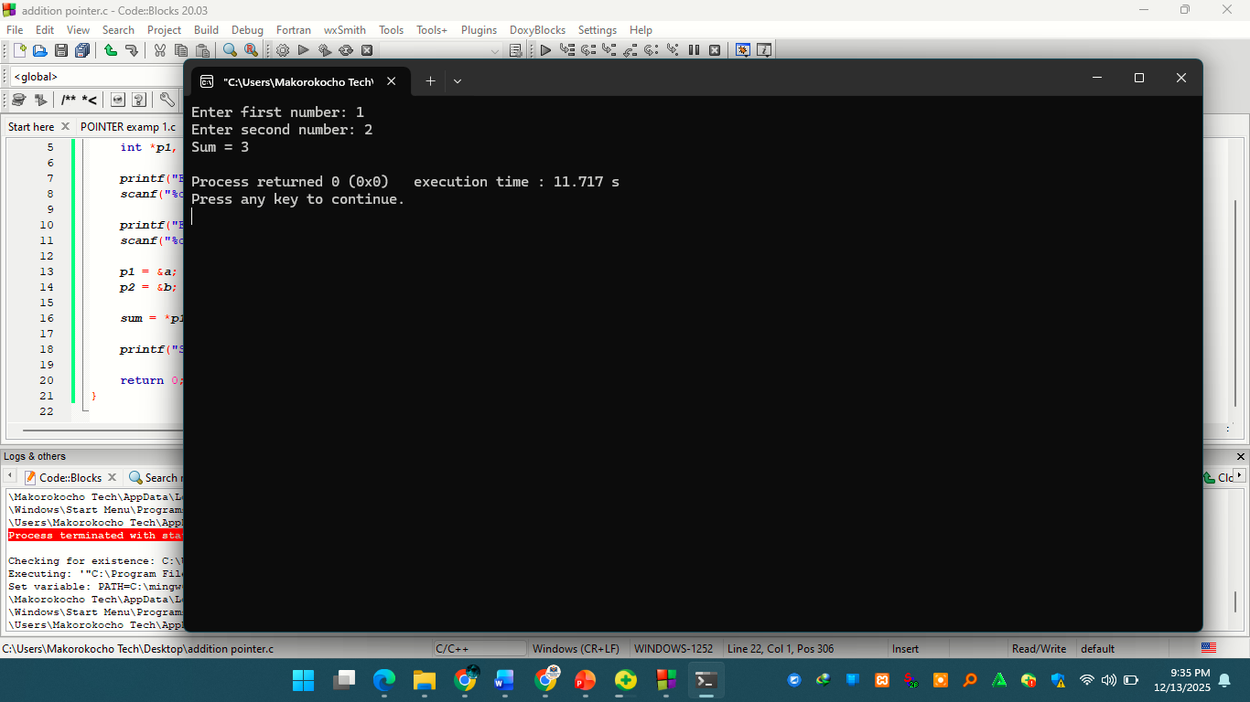
Output of C program

Slide 48
Meaning of void in C
In C, void is a keyword that represents “no type” or “nothing.”
It is used when a function does not return a value, when a function takes no parameters, or when a pointer can refer to data of any type

Slide 49
Uses of void in C
void is used in four main contexts:
void as a function return type
void in function parameters
void pointers
void with sizeof and type casting (indirect usage)

Slide 50
void as a function return type
A function is a block of code which only runs when it is called
Functions are used to perform certain actions, and they are important for reusing code: Define the code once, and use it many times.
When a function is declared with void as its return type, it means:
The function does not return any value
It performs an action only

Slide 51
void as a Function Return Type example
#include <stdio.h>
void displayMessage() {
printf("Welcome to Group number 9\n");
}
int main() {
displayMessage();
return 0;
}

Slide 52
void as a Function Return Type example explained
displayMessage() performs an action (printing output)
It does not return any value
Therefore, its return type is void
Using return; alone is allowed

Slide 53
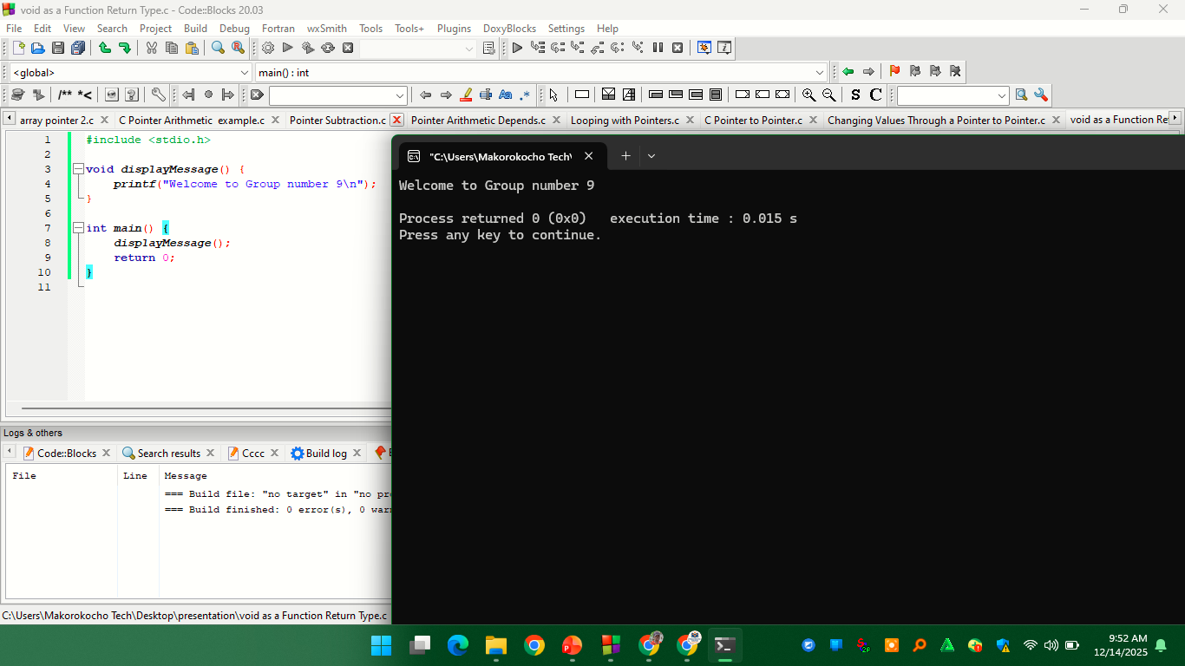
void as a Function Return Type example output

Slide 54
void in function parameters
void is used to indicate that a function takes no parameters.
Using void in a function parameter list means:
The function accepts no arguments
Example.
#include <stdio.h>
int getNumber(void) {
return 10;
}
int main() {
int x = getNumber();
printf("%d\n", x);
return 0;
}

Slide 55
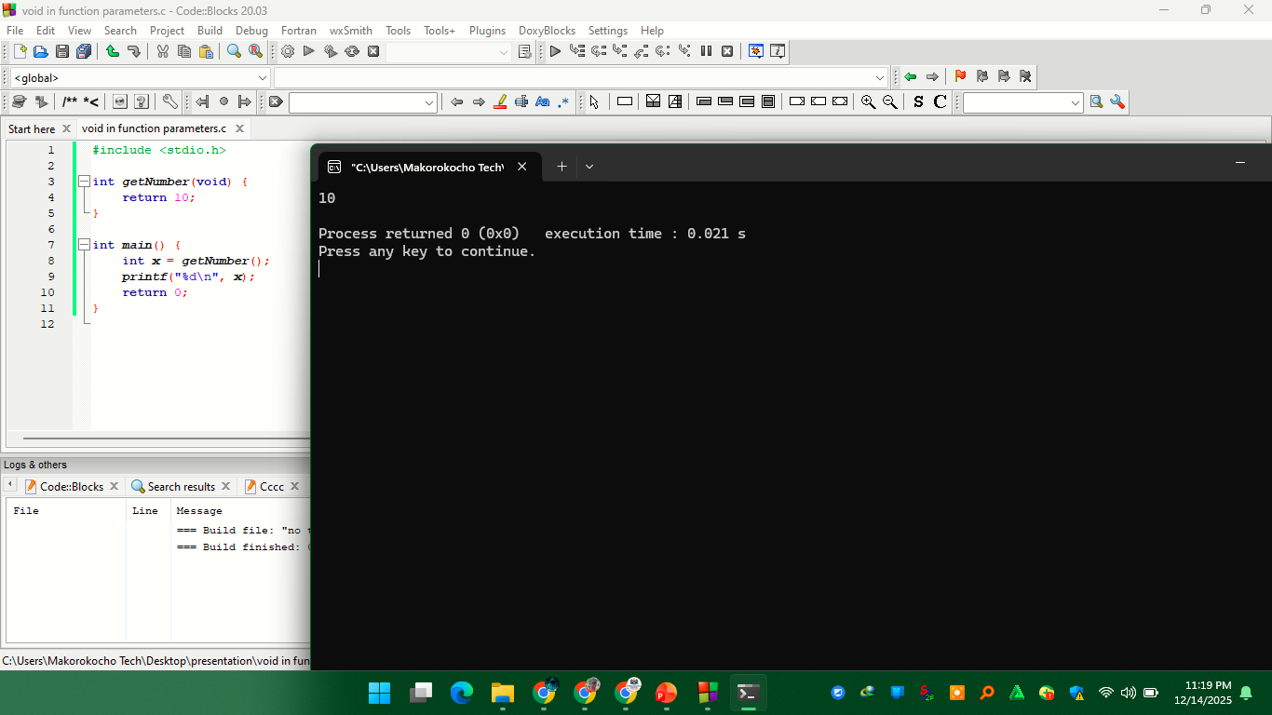
void in function parameters output

Slide 56
void pointers
A void pointer is a pointer that can store the address of any data type.
It is also known as a generic pointer.
Example.
#include <stdio.h>
int main() {
int a = 10;
float b = 5.5;
void *ptr;
ptr = &a;
printf("Integer value: %d\n", *(int *)ptr);
ptr = &b;
printf("Float value: %.2f\n", *(float *)ptr);
return 0;
}

Slide 57
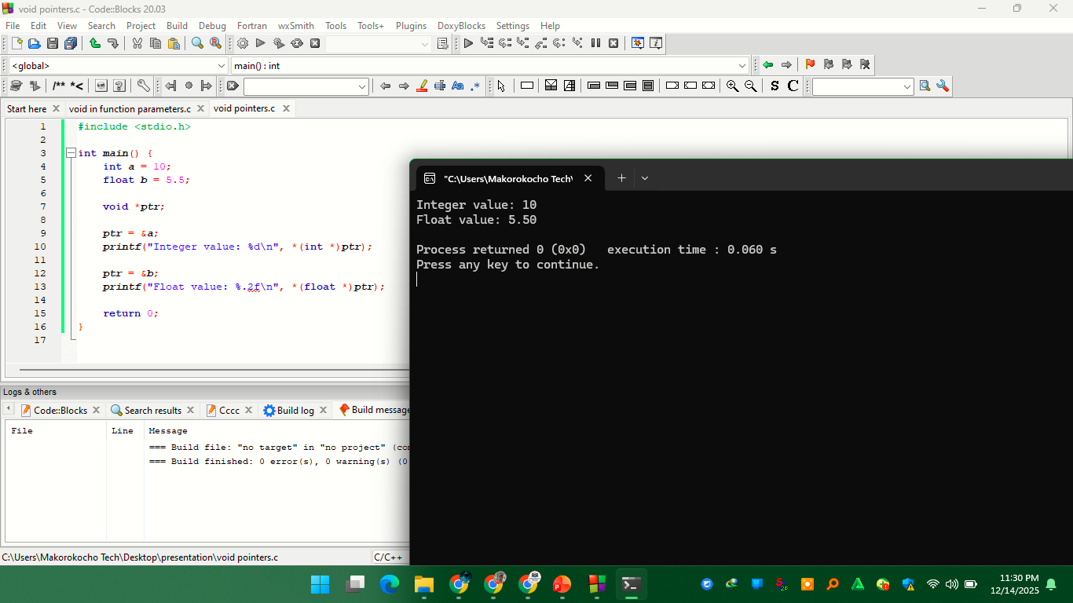
void pointers output

Slide 58
ALGORITHMS AND C PROGRAMS TO DEMONSTRATE void IN C
Demonstration of void as a Function Return Type
Problem Statement
To Write a program that displays a message using a function that does not return any value.
Algorithm 1: void Function Without Return Value
Start
Define a function with return type void
Inside the function, display a message
Call the function from main()
Stop

Slide 59
Demonstration of void as a Function Return Type
#include <stdio.h>
void displayMessage() {
printf("This is group number 9\n");
}
int main() {
displayMessage();
return 0;
}

Slide 60
Demonstration of void as a Function Parameter
Problem Statement
To Write a program where a function takes no arguments using void.
Algorithm 2: Function With void Parameter
Start
Define a function with void parameter list
Return an integer value
Call the function without arguments
Display the returned value
Stop

Slide 61
Function With void Parameter
#include <stdio.h>
int getValue(void) {
return 100;
}
int main() {
int x = getValue();
printf("Value: %d\n", x);
return 0;
}

Slide 62
Demonstration of void * Pointer and Type Casting
Problem Statement
Write a program to store and display values of different data types using a void pointer.
Algorithm 3: void * with Type Casting
Start
Declare an integer and a float variable
Declare a void pointer
Assign address of integer to the pointer
Type cast and display the integer value
Assign address of float to the pointer
Type cast and display the float value
Stop

Slide 63
void * with Type Casting
#include <stdio.h>
int main() {
int a = 10;
float b = 5.5;
void *ptr;
ptr = &a;
printf("Integer value: %d\n", *(int *)ptr);
ptr = &b;
printf("Float value: %.2f\n", *(float *)ptr);
return 0;
}

Slide 64
Demonstration of void with sizeof (Indirect Usage)
Problem Statement
To Write a program to display the size of a void pointer and an integer
Algorithm 4: sizeof with void *
Start
Declare a void pointer
Use sizeof to find size of the pointer
Display the result
Stop

Slide 65
sizeof with void *
#include <stdio.h>
int main() {
void *ptr;
printf("Size of void pointer: %lu bytes\n", sizeof(ptr));
printf("Size of int: %lu bytes\n", sizeof(int));
return 0;
}

Slide 66
Demonstration of void with Dynamic Memory Allocation
Problem Statement
Write a program to allocate memory dynamically using a void pointer and store an integer value.
Algorithm 5: void with malloc()
Start
Allocate memory using malloc()
Store the returned address in a void pointer
Type cast and assign an integer value
Display the value
Free the allocated memory
Stop

Slide 67
void with malloc()
#include <stdio.h>
#include <stdlib.h>
int main() {
void *ptr;
ptr = malloc(sizeof(int));
if (ptr == NULL) {
printf("Memory allocation failed\n");
return 1;
}
*(int *)ptr = 40;
printf("Stored value: %d\n", *(int *)ptr);
free(ptr);
return 0;
}

Slide 68
References
https://www.w3schools.com/c/c_pointers.php
https://www.w3schools.com/c/c_functions.php

